Slide 1
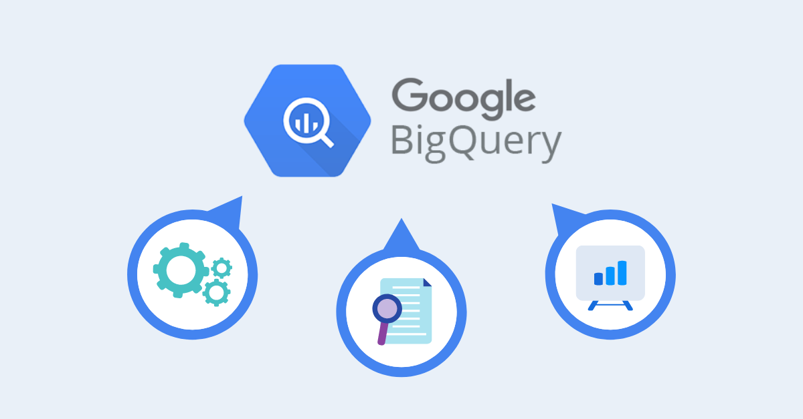
Google BigQuery – In Depth
By - Abhishek Batra – Data Architect

Slide 2
Section 1:- GCP - Overview
Google Resource Manager

Slide 3
Google Resource Manager
Google Cloud provides resources such as organizations and projects that allow you to group and hierarchically organize other Google Cloud resources.
This hierarchical organization helps you manage common aspects of your resources, such as access control and configuration settings.
The Resource Manager API enables you to programmatically manage these resources.

Slide 4
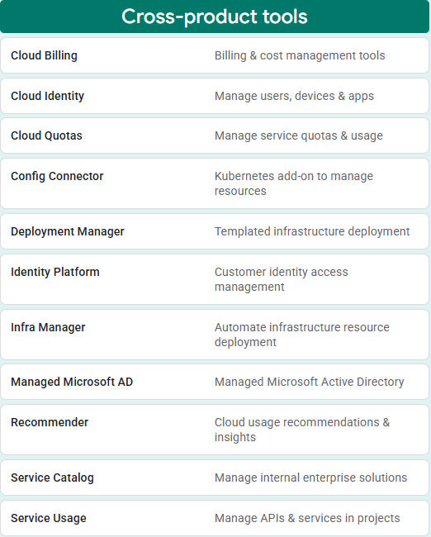
GCP Resources
Cross-product Tools

Slide 5
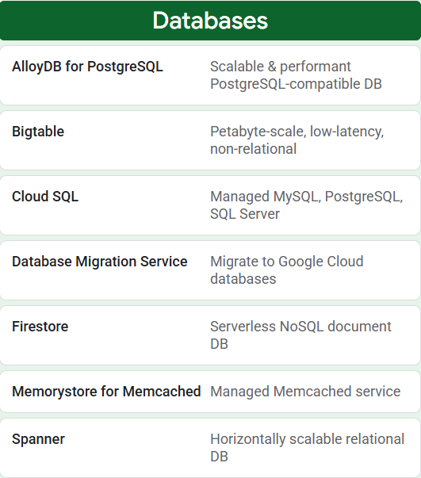
GCP Resources
Databases

Slide 6
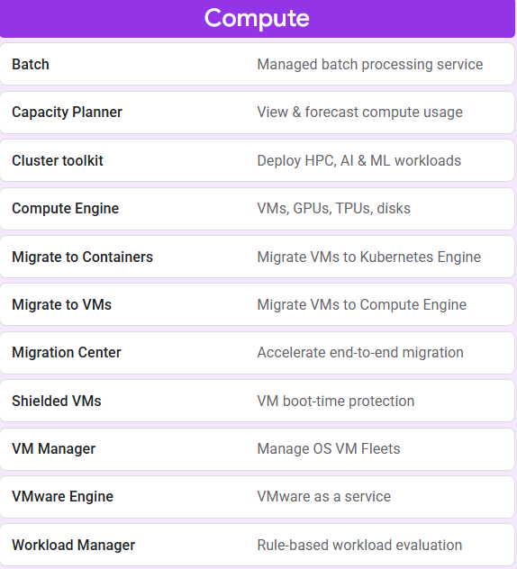
GCP Resources
Compute

Slide 7
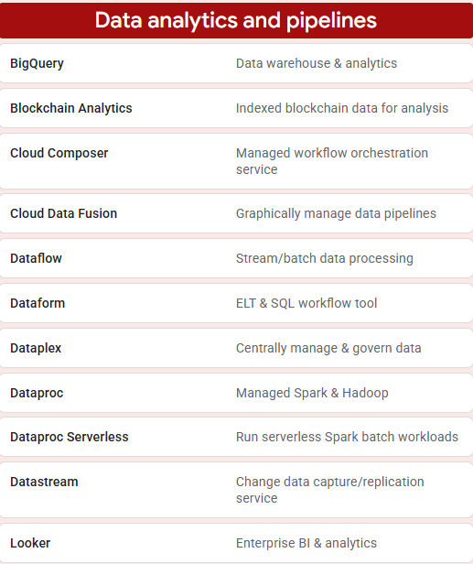
GCP Resources
Data Analytics & Pipeline

Slide 8
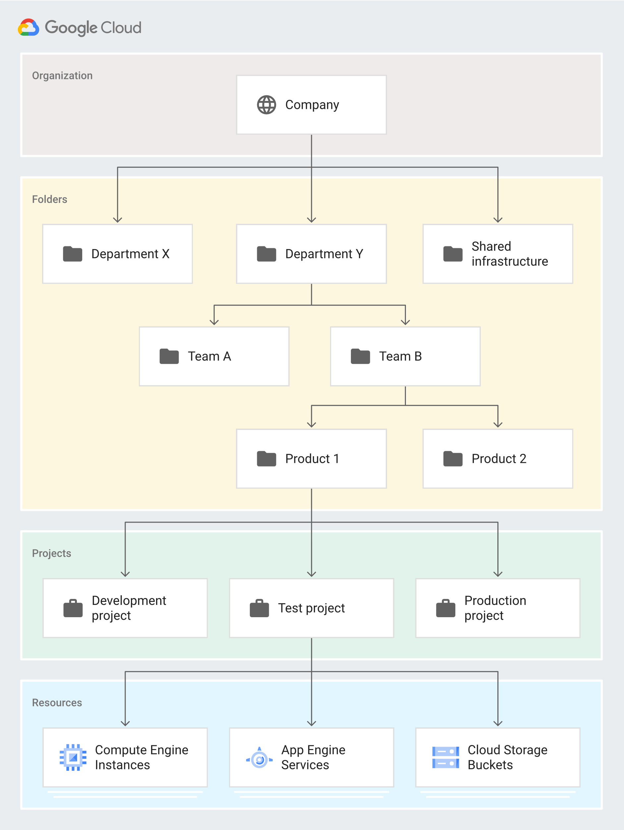
Resource Hierarchy
Overview

Slide 9



Resource Hierarchy
Organization resource
Folder resource
Project resource
The organization resource represents an organization (for example, a company) and is the root node in the Google Cloud resource hierarchy when present.
The organization resource is the hierarchical ancestor of folder and project resources.
The IAM access control policies applied on the organization resource apply throughout the hierarchy on all resources in the organization.
Folder resources optionally provide an additional grouping mechanism and isolation boundaries between projects.
They can be seen as sub-organizations within the organization resource.
Folder resources can be used to model different legal entities, departments, and teams within a company.
For example, a first level of folder resources could be used to represent the main departments in your organization resource.
The project resource is the base-level organizing entity.
Organization and folder resources may contain multiple projects.
A project resource is required to use Google Cloud, and forms the basis for creating, enabling, and using all Google Cloud services, managing APIs, enabling billing, adding and removing collaborators, and managing permissions.

Slide 10
IAM Policy Inheritance
IAM Stands for Identity Access Management
IAM lets you grant granular access to specific Google Cloud resources and helps prevent access to other resources
IAM lets you adopt the security principle of least privilege, which states that nobody should have more permissions than they require
IAM lets you control who (users) has what access (roles) to which resources by setting IAM policies on the resources.
You can set an IAM policy at the organization level, the folder level, the project level, or the resource level
Resources inherit the policies of the parent resource
If you set a policy at the organization level, it is inherited by all its child folder and project resources, and if you set a policy at the project level, it is inherited by all its child resources
The effective policy for a resource is the union of the policy set on the resource and the policy inherited from its ancestors
Resources inherit policies from the project, which inherit policies from the organization resource. Therefore, the organization-resource-level policies also apply at the resource level

Slide 11
Section 2:- BigQuery Architecture
Google BigQuery

Slide 12
Architecture
BigQuery’s serverless architecture decouples storage and compute and allows them to scale independently on demand.
Structure offers both immense flexibility and cost controls for customers because they don’t need to keep their expensive compute resources up and running all the time.
Under the hood, BigQuery employs a vast set of multi-tenant services driven by low-level Google infrastructure technologies like Dremel, Colossus, Jupiter and Borg.

Slide 13
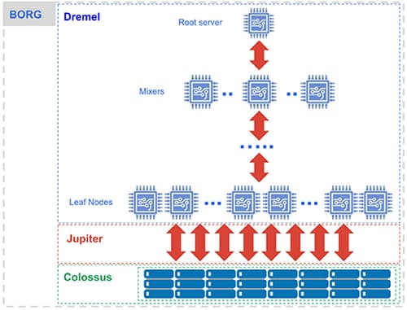
BigQuery Components
Compute is Dremel, a large multi-tenant cluster that executes SQL queries.
Storage is Colossus, Google’s global storage system.
Compute and storage talk to each other through the petabit Jupiter network.
BigQuery is orchestrated via Borg, Google’s precursor to Kubernetes.

Slide 14

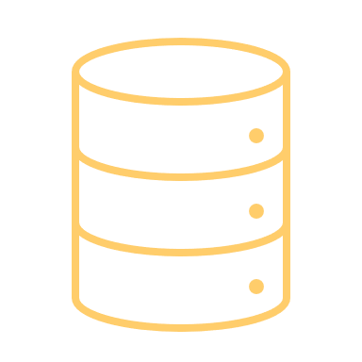

The Components
Dremel
Colossus
Jupiter & Borg
Dremel turns SQL queries into execution trees.
The leaves of the tree are called slots and do the heavy lifting of reading data from storage and any necessary computation.
The branches of the tree are ‘mixers’, which perform the aggregation.
BigQuery leverages the columnar storage format and compression algorithm to store data in Colossus, optimized for reading large amounts of structured data.
Colossus also handles replication, recovery (when disks crash) and distributed management (so there is no single point of failure).
Colossus allows BigQuery users to scale to dozens of petabytes of data stored seamlessly, without paying the penalty of attaching much more expensive compute resources as in traditional data warehouses.
In between storage and compute is ‘shuffle’, which takes advantage of Google’s Jupiter network to move data extremely rapidly from one place to another.
The mixers and slots are all run by Borg, which allocates hardware resources.

Slide 15
Section 3:- BigQuery Storage
Overview Of Storage

Slide 16
Storage -BigQuery Resource Model
BigQuery organizes data tables into units called datasets.
Datasets are scoped to a GCP project. These multiple scopes—project, dataset, and table—helps you structure your information logically.
Use multiple datasets to separate tables pertaining to different analytical domains, and you can use project-level scoping to isolate datasets from each other according to your business needs.

Slide 17
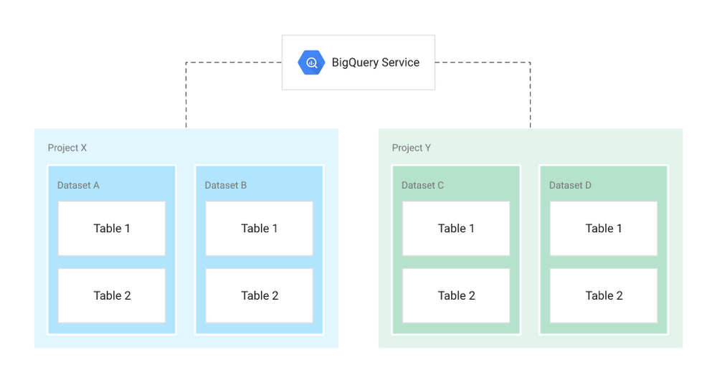
BigQuery Storage
Datasets
Collections of “related” tables/views together with labels and description
Allow storage access control at Dataset level
Define location of data i.e. multi-regional (US, EU) or regional (asia-northeast1)
Tables
Collections of columns and rows stored in managed storage
Defined by a schema with strongly-typed columns of values
Allow access control at Table level and Column level

Slide 18
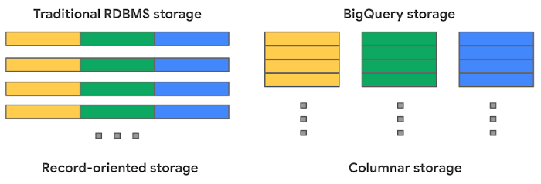
Traditional RDBMS Vs BigQuery
Traditional RDBMS
BigQuery
Traditional relational databases, like MySQL, store data row-by-row (record-oriented storage). This makes them good at transactional updates and OLTP (Online Transaction Processing) use cases.
BigQuery, on the other hand, uses columnar storage, where each column is stored in a separate file block. This makes BigQuery an ideal solution for OLAP (Online Analytical Processing) use cases.
You can stream (append) data easily to BigQuery tables and update or delete existing values. BigQuery supports mutations (INSERT, UPDATE, MERGE, DELETE) without limits.

Slide 19
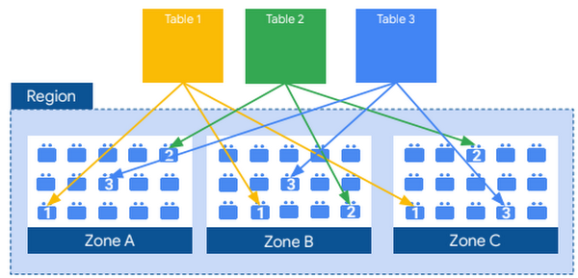
Columnar Storage
BigQuery uses variations and advancements on columnar storage.
Internally, BigQuery stores data in a proprietary columnar format called Capacitor, which has several benefits for data warehouse workloads.
Each column in the table is stored in a separate file block and all the columns are stored in a single capacitor file, which are compressed and encrypted on disk.
BigQuery uses query access patterns to determine the optimal number of physical shards and how data is encoded.
The actual persistence layer is provided by Google’s distributed file system, Colossus, where data is automatically compressed, encrypted, replicated, and distributed

Slide 20
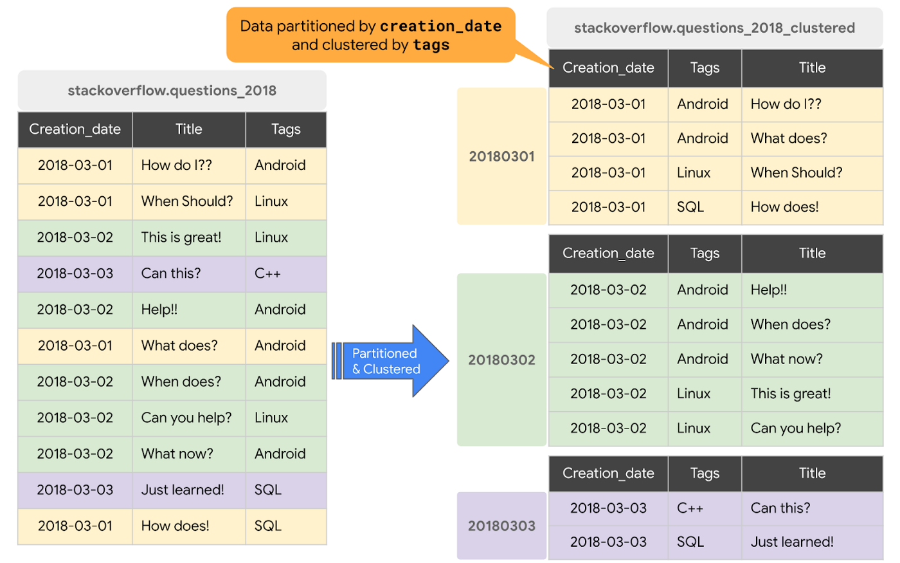
Partitioning And Clustering

Slide 21
Partitioning & Clustering
Partitioning
Clustering
A partitioned table is a special table that is divided into segments, called partitions, that make it easier to manage and query your data.
We can split large tables into many smaller partitions using data ingestion time or TIMESTAMP/DATE column or an INTEGER column.
Once slot workers read their data from disk, BigQuery can automatically determine more optimal data sharding and quickly repartition data using BigQuery’s in-memory shuffle service.
The table data is automatically organized based on the contents of one or more columns in the table’s schema.
The columns specified are used to collocate related data.
When data is written to a clustered table, BigQuery sorts the data using the values in the clustering columns.
The order of clustered columns determines the sort order of the data. When new data is added to a table or a specific partition, BigQuery performs automatic re-clustering in the background to restore the sort property of the table or partition. Auto re-clustering is completely free and autonomous for the users.

Slide 22
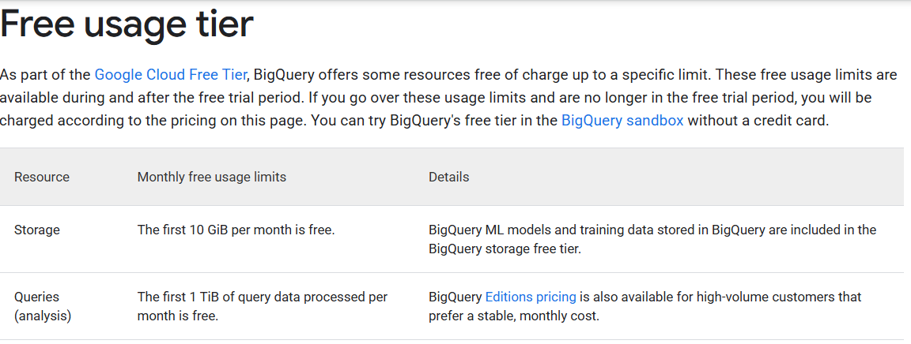
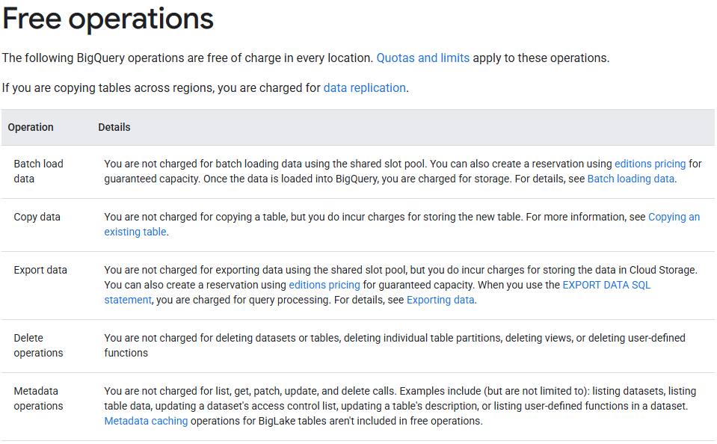
BigQuery Pricing
Compute pricing is the cost to process queries, including SQL queries, user-defined functions, scripts, and certain data manipulation language (DML) and data definition language (DDL) statements.
Storage pricing is the cost to store data that you load into BigQuery.
For more details please visit -
Pricing | BigQuery: Cloud Data Warehouse | Google Cloud
On Demand Pricing
Storage Pricing
Data Ingestion Pricing
Data Exctraction Pricing

Slide 23
THANK YOU!

